Slide 1
Load-Optimal Local Fast Rerouting for Relisient Networks

Slide 2
About the article
Need for faster failover protocol when mutiplie edge fall out.
Not using pacake tagging. (Additional information for packages to rerouing)
Build a static failover matrix in order that the alternative route should not be recoputied in runtime.

Slide 3
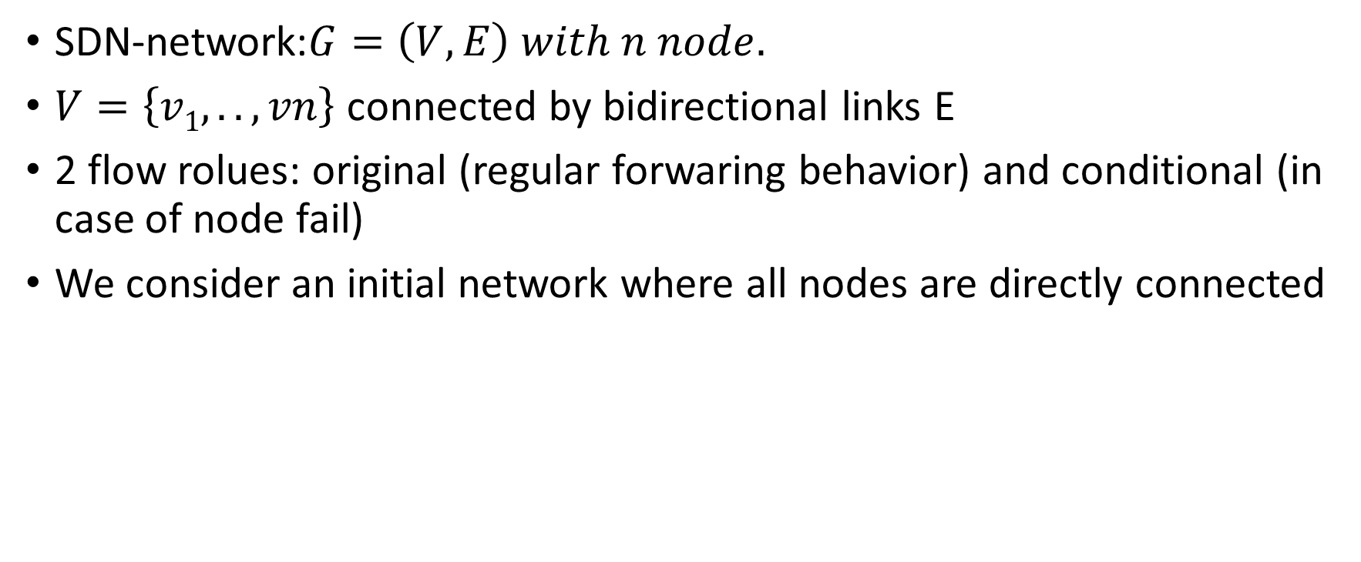
Problem statement model
SDN-network:$G=\left(V, E\right) with n node.$
$V=\left\{v1, .. , vn\right\}$ connected by bidirectional links E
2 flow rolues: original (regular forwaring behavior) and conditional (in case of node fail)
We consider an initial network where all nodes are directly connected

Slide 4

Main definitions
Load overhead: $φ\left(e\right)$ is a number of corrsing flow considering an e edge due the reouring.$φ=\max{φ\left(e\right)}$
Optimal attack: $F ⊆E$ that generates the worst overhead load $θ$. $F\left(φ\right)$_{o} is the minimal required number of failures leading to an overhead load$φ$

Slide 5
Failover matrix model
Using All-to One routing
n flow, n node
S failover schame repesented as M = [m_{i},_{j}]
i^{th} flow means: we want to foward a message from s_{i} to d_{i}. If there is not direct link between them we using the ith flow to search alternative routes for the d_{i}.

Slide 6

1
6
2
$$\left[1, 2, 3, 4, 5, 6\right]$$
5
3
4

Slide 7

1
6
2
$$\left[1, 2, 3, 4, 5, 6\right]$$
5
3
4

Slide 8

1
6
2
$$\left[1, 2, 3, 4, 5, 6\right]$$
5
3
4

Slide 9

1
6
2
$$\left[1, 2, 3, 4, 5, 6\right]$$
5
3
4

Slide 10
1
6
2
$$\left[1, 2, 3, 4, 5, 6\right]$$
5
3
4

Slide 11
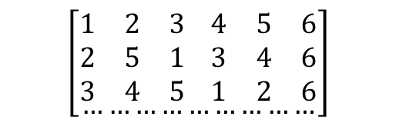
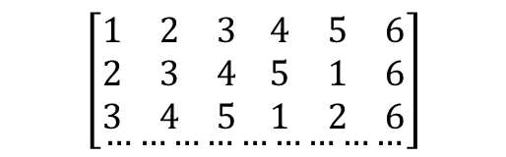
Performance
Let F = {(1,6), (2,6), (3,6)}
$$\left[\begin{aligned}\begin{matrix}1 & 2 & 3 \\ 2 & 3 & 4 \\ 3 & 4 & 5\end{matrix} \begin{matrix}4 & 5 & 6 \\ 5 & 1 & 6 \\ 1 & 2 & 6\end{matrix} \\ ………………………\end{aligned}\right]$$
$$\left[\begin{aligned}\begin{matrix}1 & 2 & 3 \\ 2 & 5 & 1 \\ 3 & 4 & 5\end{matrix} \begin{matrix}4 & 5 & 6 \\ 3 & 4 & 6 \\ 1 & 2 & 6\end{matrix} \\ ………………………\end{aligned}\right]$$
vs
The resulting overhead load is 3 on (4,6) in the left matrix while it is 2 on the rigth.
The worst perfromace comes from the simialarity of each node scheme.

Slide 12
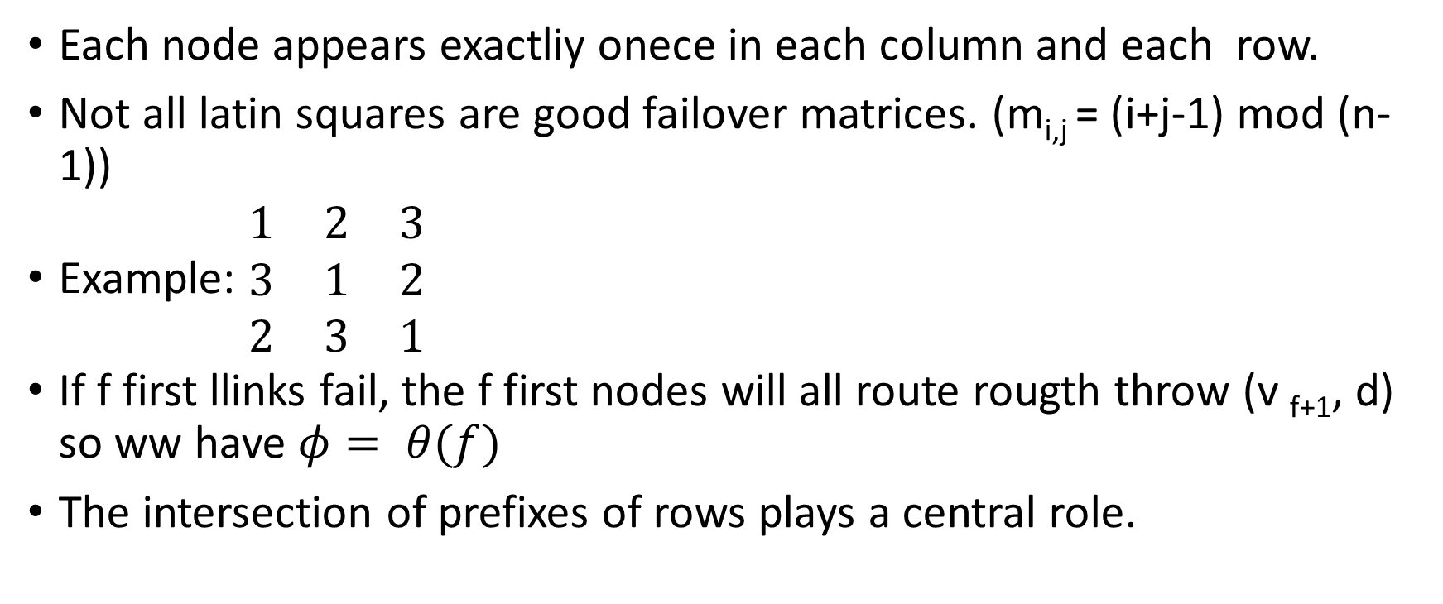
Latin square shcmaes
Each node appears exactliy onece in each column and each row.
Not all latin squares are good failover matrices. (m_{i,j} = (i+j-1) mod (n-1))
Example: $\begin{matrix}1 & 2 & 3 \\ 3 & 1 & 2 \\ 2 & 3 & 1\end{matrix}$
If f first llinks fail, the f first nodes will all route rougth throw (v _{f+1}, d) so ww have $φ= θ(f)$
The intersection of prefixes of rows plays a central role.

Slide 13
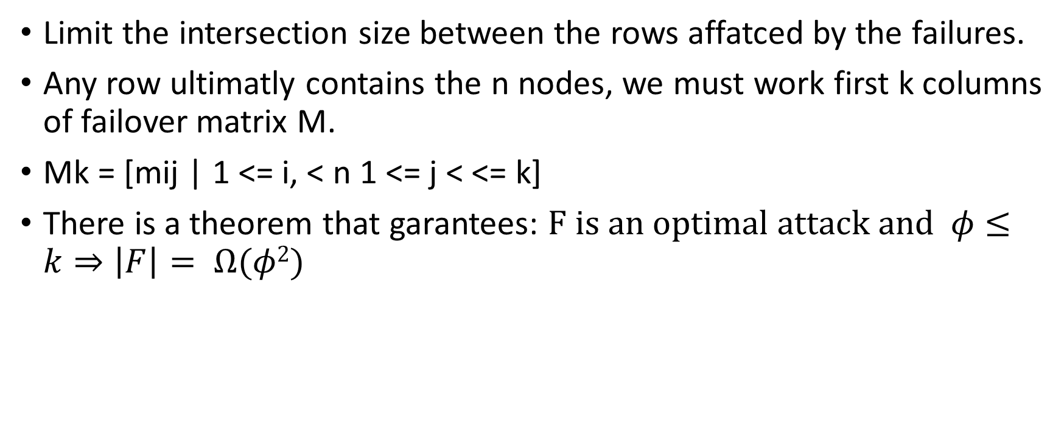
M^{k} matrix
Limit the intersection size between the rows affatced by the failures.
Any row ultimatly contains the n nodes, we must work first k columns of failover matrix M.
Mk = [mij | 1 <= i, < n 1 <= j < <= k]
There is a theorem that garantees: $F is an optimal attack and φ≤k⇒\left|F\right|= Ω(φ2)$

Slide 14
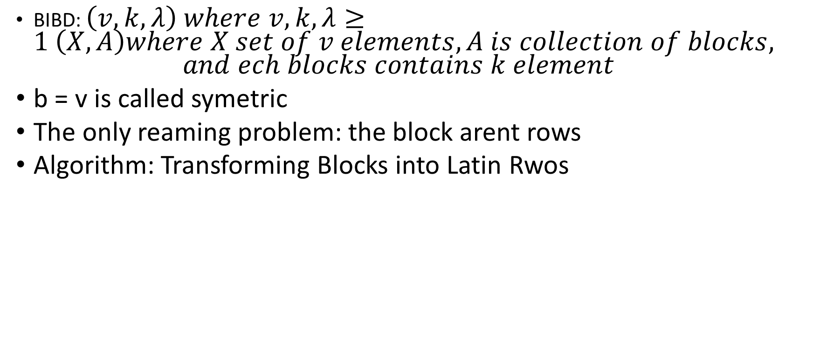
How to create submatrices of low intersection
BIBD: $\left(v, k, λ\right) where v,k, λ≥1 \left(X,A\right)where X set of v elements, A is collection of blocks,$ $and ech blocks contains k element$
b = v is called symetric
The only reaming problem: the block arent rows
Algorithm: Transforming Blocks into Latin Rwos

Slide 15

1,4
1
3,4
2
$\begin{matrix}1 \\ 4 \\ \begin{aligned}2 \\ 3\end{aligned}\end{matrix}$
1,2
3
3,2
4

Slide 16

1,4
1
3,4
2
$\begin{matrix}1 \\ 4 \\ \begin{aligned}2 \\ 3\end{aligned}\end{matrix}$ $\begin{matrix}4 \\ 3 \\ \begin{aligned}1 \\ 2\end{aligned}\end{matrix}$
1,2
3
3,2
4

Slide 17
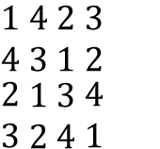
1,4
1
3,4
2
$\begin{matrix}1 \\ 4 \\ \begin{aligned}2 \\ 3\end{aligned}\end{matrix}$ $\begin{matrix}4 \\ 3 \\ \begin{aligned}1 \\ 2\end{aligned}\end{matrix}$ $\begin{matrix}2 \\ 1 \\ \begin{aligned}3 \\ 4\end{aligned}\end{matrix}$ $\begin{matrix}3 \\ 2 \\ \begin{aligned}4 \\ 1\end{aligned}\end{matrix}$
1,2
3
3,2
4
Run algorithm with complementer blocks

Slide 18

Prmutation routing
Generalize All-to One routing to permutation routing problem.
$π :V →V each node v communicates with its image π(v)$

